Slide 1
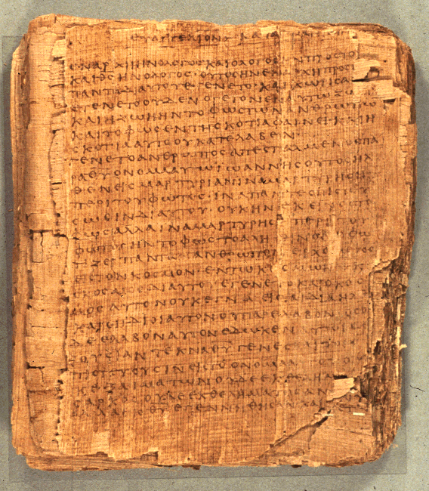
How to Read the Psalms
Dr. Rodney K. Duke
BUMC Spring 2026

Slide 2
CLASS 1
Assign: (see handouts pp 3-4, “Assignments”)
Write a journal reflection entry (for each class)
Assignment #1. (You will read 10 assigned psalms and come up with a tentative descriptive definition of psalms in general. (Think about style and not just content.)
Day Objectives:
1) Reflect on a simple, close reading.
2) Explain the course goals and objectives.
3) Identify the structure and content of the Hebrew Bible/OT. 4) Explain the process of successful communication and how you can apply it to interpreting the Psalms (Bible).

Slide 3

SUGGESTION: KEEP A JOURNAL
(perhaps separate sections)
The assignments -- as you are able.
What you observe on your own belongs to you. You will remember and value it more than what I can ever say.
Questions: These will help to generate in-class discussions.
Class notes: any details that you want to retain.
Main reflection: (right after class). Your main thought or something someone said that was significant to you.
Devotional thoughts and prayers inspired by the psalms

Slide 4
GENERAL GOALS
We cannot know what a text means until we know how it means.
Main objective:
Develop skill in reading and comprehending the Psalms (and other OT hymns) within their cultural and historical context, in order to appreciate them more and apply them better.
How to read them in according to their:
Genre (typical forms)
Literary patterns (parallelism and other patterns)
Typical imagery
Cultic* setting in their performance in the Temple * cultic used here for religious expression or practice
Historical allusions (some explicitly to the life of David)
Main theological themes
[The later Church’s Christological interpretation]

Slide 5
ILLUSTRATION OF A SIMPLE CLOSE READING
PSALM 1:1
Type (thematic): Wisdom Psalm
Blessed is the one who does not walk in the advice of the wicked, and in the way of sinners does not stand, and in the assembly of scoffers does not dwell; but rather in the Law of Yahweh is his delight, and in His Torah he meditates day and night.

Slide 6
PSALM 1:1
Literary feature: contrast / comparison (antithesis)
Blessed is the one who
[Negative picture]
does not walk in the advice of the wicked
and in the way of sinners does not stand
and in the assembly of scoffers does not dwell
But rather
[Positive picture]
in the Law of Yahweh is his delight
and in His Torah he meditates day and night.

Slide 7
PSALM 1:1
Literary feature: chiastic and simple structural repetition
Blessed is the one who
[A behavior] [B setting]
does not walk / in the advice of the wicked
[B setting] [A behavior]
and in the way of sinners / does not stand
[B setting] [A behavior]
and in the assembly of scoffers / does not become dwell
But rather
[B setting] [A behavior]
in the Law of Yahweh / is his delight
[B setting] [A behavior]
and in His Torah / he meditates day and night.

Slide 8
PSALM 1:1
Literary features: word imagery and development, hendiadys
Blessed is the one who
[Progresson of sin]
does not WALK / in the advice of the wicked
and in the way of sinners / does not STAND
and in the assembly of scoffers / does not DWELL
[Prevention of sin]
But rather
in the Law of Yahweh / is his delight
and in His Torah / he meditates [“murmurs”] day and night.
hendiadys
Notes:
Walk > stand > dwell. Sin presented as selecting a course emphasizes moral choice; then choosing to remain, then habitate.
Wicked = contra what is righteous, mistreatment of people
Sinners = more an emphasis on lawless in terms of God’s law
Scoffers = prideful scorn of godliness

Slide 9
(HO p, 6)
Hymnic, wisdom, historical

Slide 10
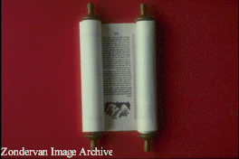
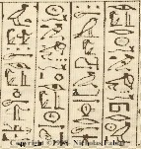
STRUCTURE OF HEBREW CANON (1of 3) (HO p. 7)
Law/Torah/Pentateuch
1. Traditional Domain: priests (preserved ritual laws, in late
period taught Torah)
2. Literary Forms: historical narratives and laws
3. Functions: to provides Israelite foundations for:
a. world-view (life-story, nature of God, world, humanity)
b. origin and purpose of Israel (covenant with God)
c. conduct (ritual, moral, social, criminal laws, etc.)

Slide 11
STRUCTURE OF HEBREW CANON (2 of 3)
Prophets
1. Traditional Domain: prophets
"Former Prophets": key characters in course of Israelite
history, believed to have kept records
"Latter Prophets": main characters and their messages
2. Literary Forms:
"Former Prophets": broad-sweeping historical narratives
"Latter Prophets": narratives focused on individuals; oral, poetic messages
3. Functions:
"Former Prophets":
a. preserve the traditions of Israel,
b. answer questions about the course their history took, evaluating their kings and nation
c. teach about the nature of reality
"Latter Prophets": hold people accountable to faith priorities
(different emphases with each prophet)
Notes:
Learning how to read hymnic literature helps with reading the Latter Prophets

Slide 12
STRUCTURE OF HEBREW CANON (3 of 3)
Writings
1. Traditional Domain: varied, but wisdom literature associated
with the sage (collected knowledge, wisdom)
2. Literary Forms: (varied) wisdom literature, hymnic lit.,
historical narrative, story
3. Functions: (varied)
a. wisdom: teach about the nature of life and how to live
skillfully
b. hymnic: implicit theology, guidance and encouragement in expressions of prayer, worship and celebration
c. narrative: (same as under "Former Prophets")
Note:
In the Hebrew Bible, Daniel, a wise age in the rulers’ court, is with the Writings and not with the Prophets! How might that influence how one reads Daniel?

Slide 13
Israelite Functionaries and Institutions (HO, p. 8)
King:
monarchy, national identity, term "messiah," Davidic dynasty
NT: David lineage, Messiah, messianic & political expectation of Jesus’ day
Priest:
Cultic rituals, holiness & purity systems, sacrificial system, Temple, Law
NT: impurity & sacrificial imagery, Jesus as High Priest, Mercy Seat (Rom 3:25), sin offering (2Cor 5:21; Rom 8:3), sanctifying blood; Sadducees; Christians as a royal priesthood
Prophet:
(unlike Ancient Near East: court/temple/shrine) independent "preacher"/ activist / demonstrator /conscience of the people
NT: John the B, Jesus, apostles, prophets, “pastors,” etc.
Sage:
court (school?) scribe (palace & temple); Joseph, Daniel
NT: wisdom forms of Jesus' teaching, Pharisees, scribes and rabbis.
NT assumes knowledge of these roles and institutions.

Slide 14
Introduction to Hymnic Lit.
If a “pocket” New Testament includes just one book from the Old Testament, which book is usually included?
Why do think this book?
How would you currently describe the “book” of Psalms?
What has the Book of Psalms meant to you? / What role should it have in the life of the Church?

Slide 15
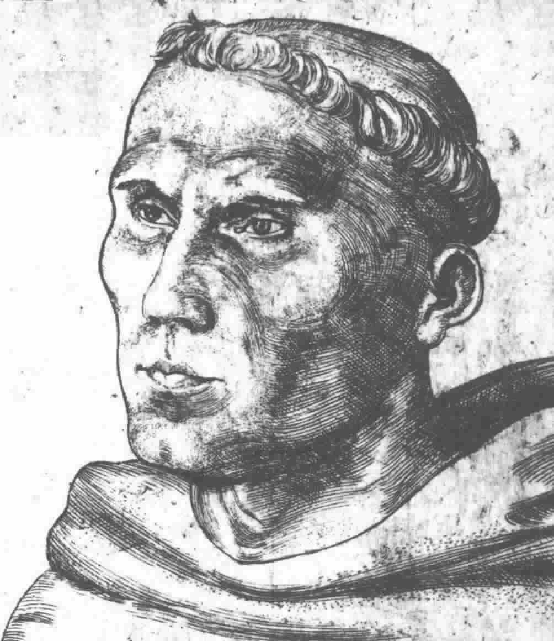
Introduction
Martin Luther on the Book of Psalms:
Where does one find finer words of joy than in the psalms of praise and thanksgiving? There you look into the hearts of all saints, as into fair and pleasant gardens, yes, as into heaven itself. There you see what fine and pleasant flowers of the heart spring up from all sorts of fair and happy thoughts toward God, because of his blessings.

Slide 16

Luther cont.
On the other hand, where do you find deeper, more sorrowful, more pitiful words of sadness than in the psalms of lamentation? There again you look into the hearts of all the saints, as into death, yes, as into hell itself. How gloomy and dark it is there, with all kinds of troubled forebodings about the wrath of God! So, too, when they speak of fear and hope, they use such words that no painter could so depict for you fear or hope, and no Cicero or other orator so portray them.

Slide 17
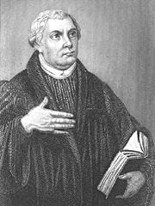
Luther cont.
And that they speak these words to God and with God, this, I repeat, is the best thing of all. This gives the words double earnestness and life…. Hence it is that the Psalter is the book of all saints; and everyone, in whatever situation he may be, finds in that situation psalms and words that fit his case, that suit him as if they were put there just for his sake, so that he could not put it better himself, or find or wish for anything better.
Luther’s Works, vol. 35: Word and Sacrament I (Fortress, 1960), pp. 255f. Taken from P. Miller, Interpreting the Psalms (Fortress, 1986), pp. 19f.

Slide 18
PROCESS OF COMMUNICATION*
*Metacognitively applying common-sense understanding about what people do to communicate effectively, goes a long way to aiding biblical interpretation!

Slide 19
IN CLASS EXERCISE (discuss with a partner and take notes)
How many different types of literature (genres) are commonly found in a hardcopy or online newspaper? (Make a list.)
Pick two quite different types from your list to think about. How do you “read” those two types differently? Identify: (a) the purposes/functions of each type, (b) what you expect to find in each type (info., style, structure), (c) the questions that will be in your mind as you read each type.
What are the implications of this exercise for reading the Bible?
Note: Fuller class exercise included with handouts, pp. 10-12.

Slide 20

How we convey meaning (1 of 3)
What must two parties do for communication to take place effectively?
They must “play by the same rules.” (language, grammar, semantics, etc.)
What is the “meaning” of a text?
Meaning is the total impact of the text on the reader.
Meaning is conveyed by form and content together.

Slide 21
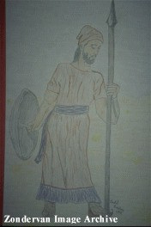
How we convey meaning (2 of 3)
What is the significance of form?
I shot him dead because because he was my foe.
I shot him dead because--
Because he was my foe,
Just so: my foe of course he was;
That’s clear enough; although
(Thomas Hardy, “The Man He Killed”)

Slide 22
How we convey meaning (3 of 3)
What is the significance of form?
Different literary forms impact the reader differently.
Recognition of the form establishes our expectations and reading strategy/interpretive decisions.
We create our message in the form which will be most effective.

Slide 23
Poles of Communication
HO pp. 13-14
Emotive
Addresser
|
Means------------------------|---------------------Referent
|
Addressee
Poetic
Referential
Conative (persuasive)
Point: Different forms of communication have different emphases and different functions.

Slide 24
Point: Different functions call for different evaluations.
Functions and Evaluation (1 of 2)
1. Water consists of 2 parts hydrogen and 1 part oxygen.
2. Napoleon originated the custom of sewing buttons on the cuffs of dress jackets.
3. I am the best candidate!
4. Use this deodorant and you will become romantic.
5. It is so hot outside, I’m burning up.
6. I love you.
7. Once upon a time a tortoise and a hare had a race….(assume the rest of the story)

Slide 25
Functions and Evaluation (2 of 2)
8.
“Fall Scene”
red
green
orange
twirls
gentle
leaf
home

Slide 26
Summary/Application on "Function and Evaluation” (1 of 2)
What can you apply from this exercise to reading the Bible?
Main Observation:
Before we as readers assess the value/meaning of a biblical text (or any text), we need to understand the intended communicative function of that text.
[Comment: When it comes to the Bible, people tend to drop their usual reading skills and read the Bible “on the flat” as if it were all referential and to be evaluated as science.]
Notes:
?

Slide 27
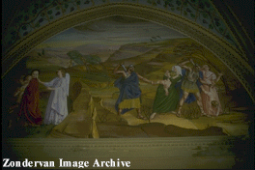
Summary/Application on "Function and Evaluation” (2 of 2)
But:
Some genres do not function referentially or conatively in a “literalistic” sense. There may be a “poetic” impact intended.
[Duke: “literal” according to context of communicative intention vs. “literalistic” ignoring contexts, intention, figurative lang. etc.]
Illust.: "If your eye causes you to sin, pluck it out....” (Conative and poetic poles work together = “hindrances to the Kingdom of God are so serious …”
b. Some texts do function referentially, but are historically referential, not scientifically referential and should be evaluated differently. (Ref #2 vs #1)

Slide 28
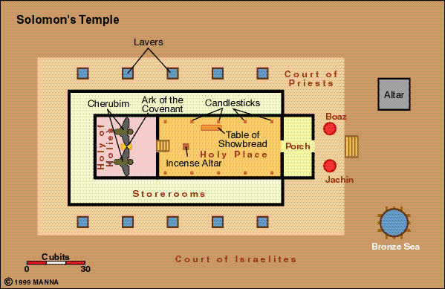
Using the Bible to compute π

Slide 29
Defining/Describing Genres
Pre-question to Assignment #1
Suppose you had to describe a genre (type of literature) that was new to you. How would you do it? What categories would you use?

